Slide 1
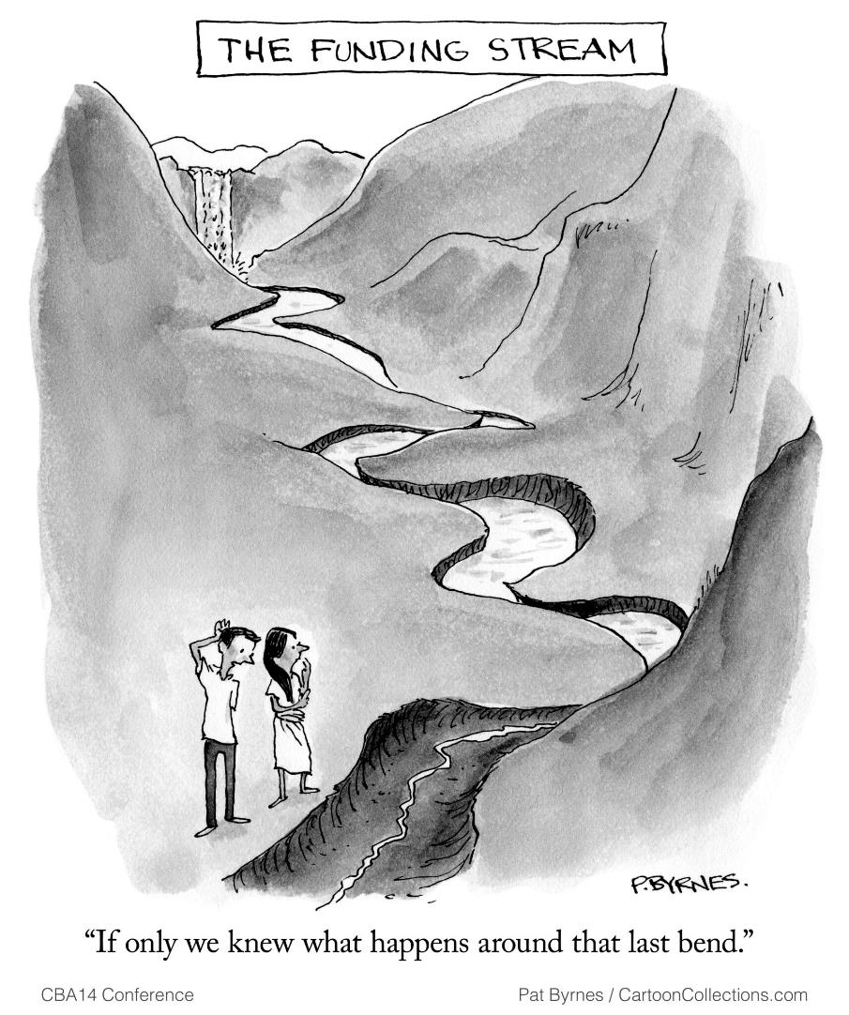
Climate finance
and health
Notes:
Photo credit: Pat Byrnes for the CBA14 Conference
Notes for the Facilitator:
Facilitator notes are provided with each slide as a support and are not comprehensive.
Facilitators are encouraged to add background information and to contextualise the presentation.
The following presentation outlines what climate finance is, how health is currently incorporated into climate finance and how national societies can engage in climate finance for health adaptation
Note: All photos in this presentation are credited to the Climate Centre unless otherwise mentioned.

Slide 2
What is climate finance?
Any funding that supports climate adaptation and mitigation
75% Mitigation
25% Adapt
50% Adaptation
75% Mitigation
50% Mitigation
Goal
2019
Notes:
Notes:
Climate finance is public or private finance dedicated to reducing greenhouse gas emissions (climate change mitigation) or strengthening the ability to manage climate change impacts (climate change adaptation). The work of National RCRC Societies on disaster risk reduction, preparedness, resilience and reducing vulnerability aligns with the purpose of finance for climate change adaptation. More background information can be found in the IFRC Climate Finance FAQ: https://ctk.climatecentre.org/downloads/modules/training_downloads/3a%20FAQ%20Climate%20finance%20and%20the%20Red%20Cross%20Red%20Crescent.pdf
.
Climate finance comes from a broad variety of sources. Most climate finance globally is in the form of loans from private banks, development banks, or governments. For national societies, grants from governments or dedicated climate funds are the most appropriate type of climate finance. These grants could come from bilateral donors, national climate funds, or multilateral climate funds like the GCF, GEF, Adaptation Fund, CREWS, or GCCA+.
Through the Paris Agreement in 2015, high income countries committed to allocating USD 100 billion a year to global mitigation and adaptation by 2020, 50% to adaptation and 50% to mitigation (UNFCCC, n.d.). This goal has yet to be achieved and the vast majority of funding is directed towards mitigation efforts. An OCED report noted that in 2019 only 80 million had been designated to climate finance with 60 billion of that going towards mitigation (Timperely, 2021).
Through the next couple of slides, we aim to tell the story of where health fits into climate adaptation funding and why it is important to include heath as an urgent priority in climate adaptation funding. Huge shout out to our colleague Rebeka Ryvola for the amazing visuals.
More relevant reading on health and climate finance can be found here: https://ctk.climatecentre.org/downloads/modules/training_downloads/2d%20Fact%20Sheet%20on%20Health%20and%20Climate%20Finance%20FEB2022.pdf
Sources:
Timperley, 2021. The broken $100-billion promise of climate finance and how to fix it. Nature. Retrieved from: https://www.nature.com/articles/d41586-021-02846-3
UNFCCC (n.d.) Climate finance in the negotiations. Retrieved from: https://unfccc.int/topics/climatefinance/the-big-picture/climate-finance-in-the-negotiations

Slide 3
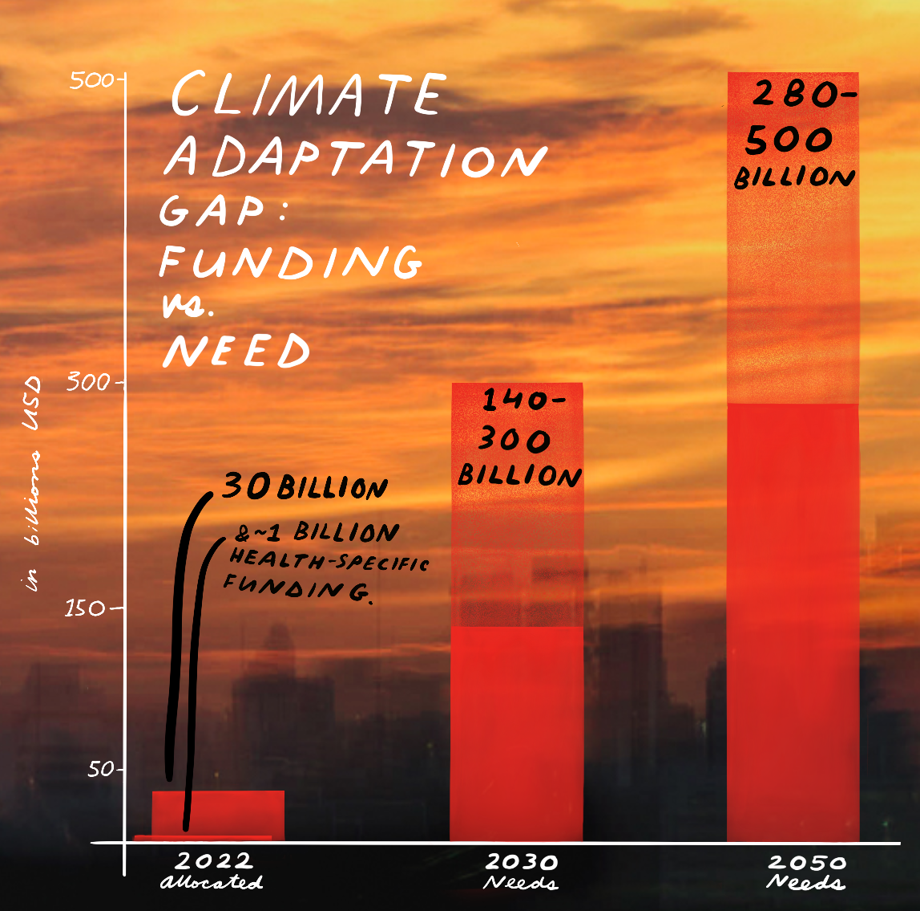
Notes:
Image credit: Rebeka Ryvola for the Red Cross Climate Centre
Notes:
Within adaptation, climate finance allocations fall far short on the needs. We have less than eight years to increase climate adaptation funding from 30 Billion to at least 140 billion to meet the funding need for climate adaptation.

Slide 4
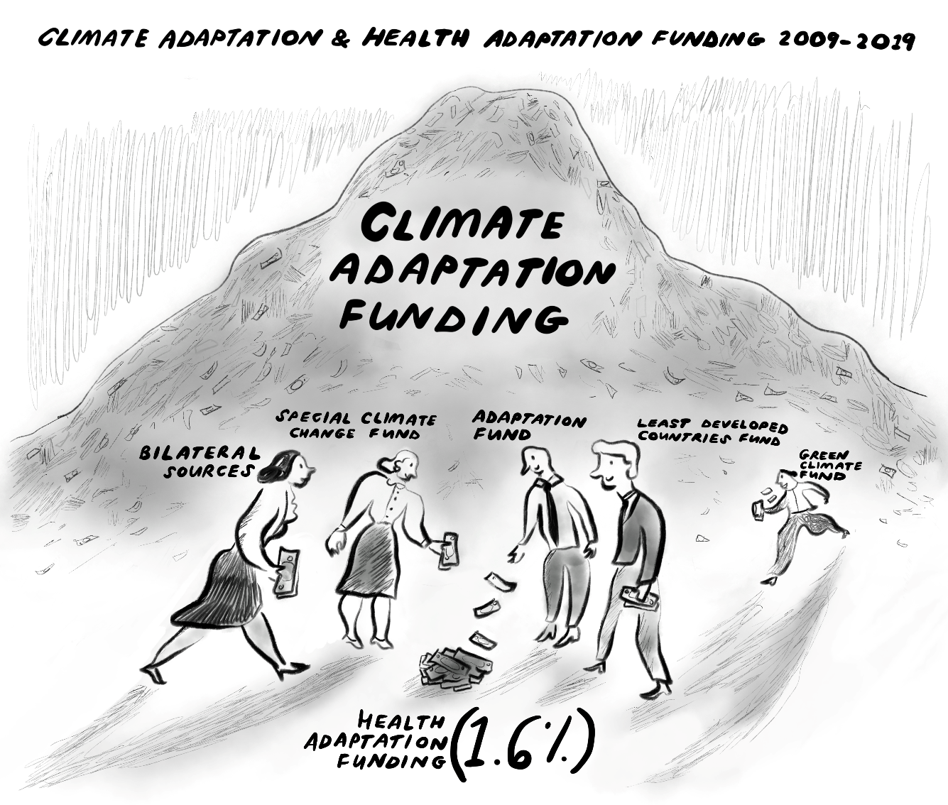
Notes:
Image credit: Rebeka Ryvola for the Red Cross Climate Centre
Notes:
Of the current climate adaptation funding, only 1.6% goes towards the health sector. Only four multilateral development banks (out of 27) have contributed to health adaptation funding with majority of the funding coming from the Green Climate Fund since 2016.
Please note:
Major climate funds are difficult to access for the Red Cross Red Crescent. Though billions of dollars are being channeled to funds like the GCF, GEF, and Adaptation Fund, accessing this finance requires completing a very costly and demanding accreditation process. As a result, most climate finance is allocated to international organisations that have the capacity to undertake accreditation. National societies cannot directly apply for climate finance from these funds, but they can be an implementing partner for an accredited entity. For example, accredited entity UNDP manages the CF project, and the NS and IFRC work as the implementing partners. Developing these partnerships is vital to be included in project concept notes and funding proposals.

Slide 5
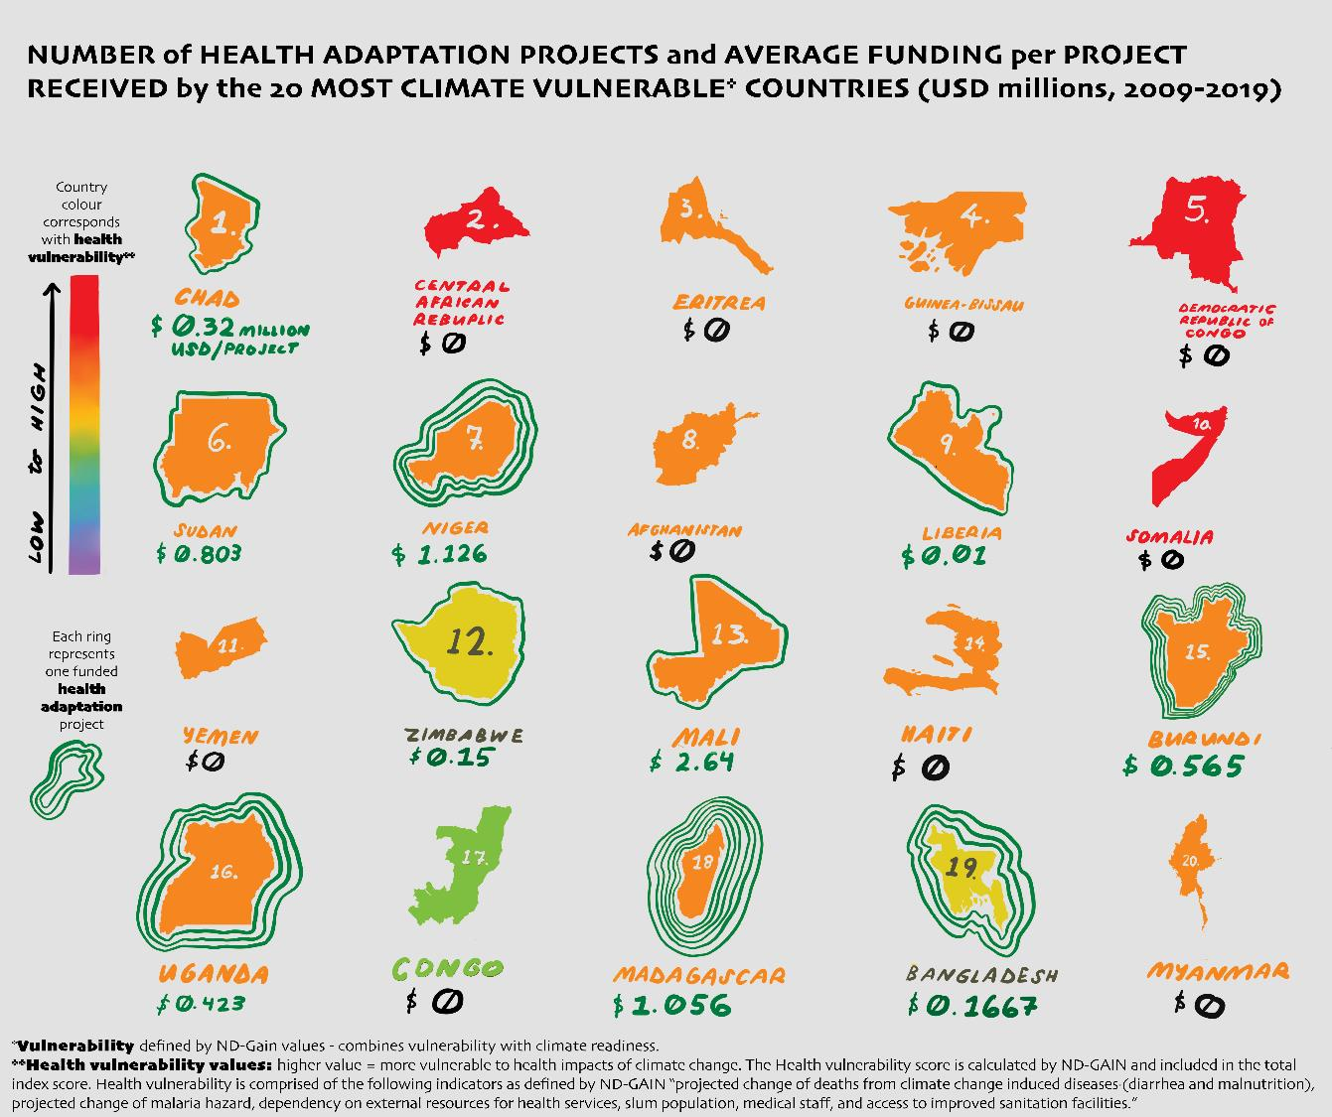
Notes:
Image credit: Rebeka Ryvola for the Red Cross Climate Centre
Notes:
When we look at where funding is being sent compared to need, you can see that often the most vulnerable countries to climate change are not getting the most funding for health-related climate adaptation. Only half of the 20 most vulnerable countries received any funding and only 1 in the bottom five. None of the countries with the highest health vulnerability as defined by ND-GAIN (shown here by the countries in red) received any funding.
All of the countries listed here received less funding per project than the average funding per project out of the 154 total health-related climate adaptation projects identified. The average funding per project is more than 4 times higher than the funding per project received by the 20 most vulnerable countries (total average = 3.038 USD millions/project; average for 20 here = 0.726 USD millions/project).
Take away messages from these three slides:
Climate adaptation finance is not enough to meet the funding need.
Only 1.6% of climate adaptation funding goes to the health sector.
Of health-related climate adaptation funding, countries that are most vulnerable are receiving less funding or no funding at all.

Slide 6
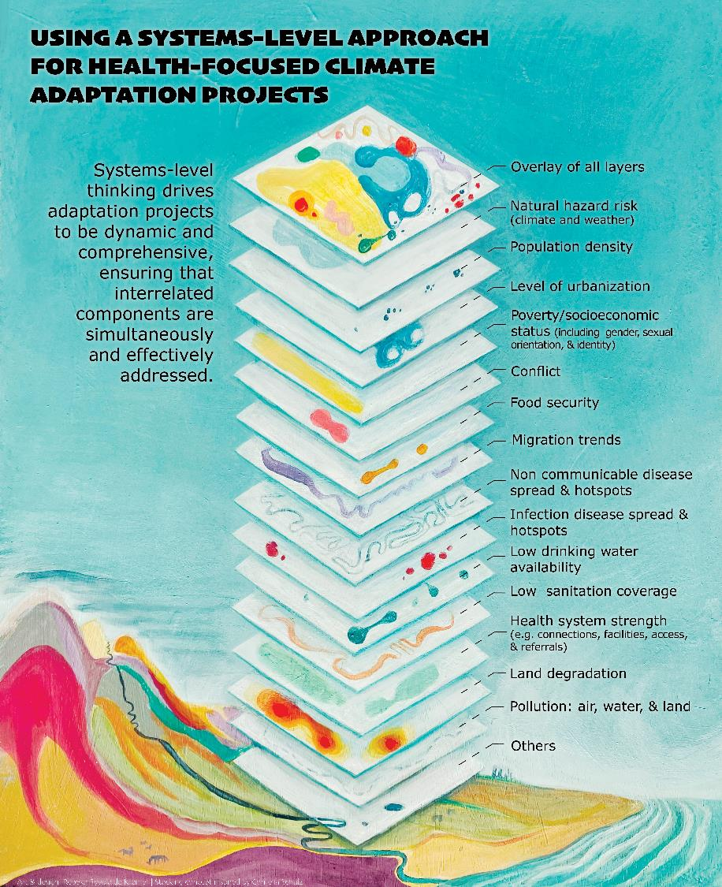
Notes:
Image credit: Rebeka Ryvola for the Red Cross Climate Centre
Notes:
Why should health-related climate adaptation be prioritized?
It is impossible to isolate the interrelated layers that determine climate vulnerability. This image shows some of the many layers that can contribute to vulnerability and amplify negative health outcomes of a climatic event. It is possible to adapt to climate change by strengthening health systems and reducing adverse health outcomes to climate impacts while ensuring that overlapping risk factors are addressed at the same time. If health systems and health consequences are not widely considered in climate adaptation initiatives, there are more likely to be negative consequences like disease, death, and trauma from disasters, sea level rise, and changes in ecosystems. This will be amplified in countries that have the least ability to adapt.
Systems-level thinking drives adaptation projects to be dynamic and comprehensive, ensuring that interrelated components are simultaneously and effectively addressed.

Slide 7
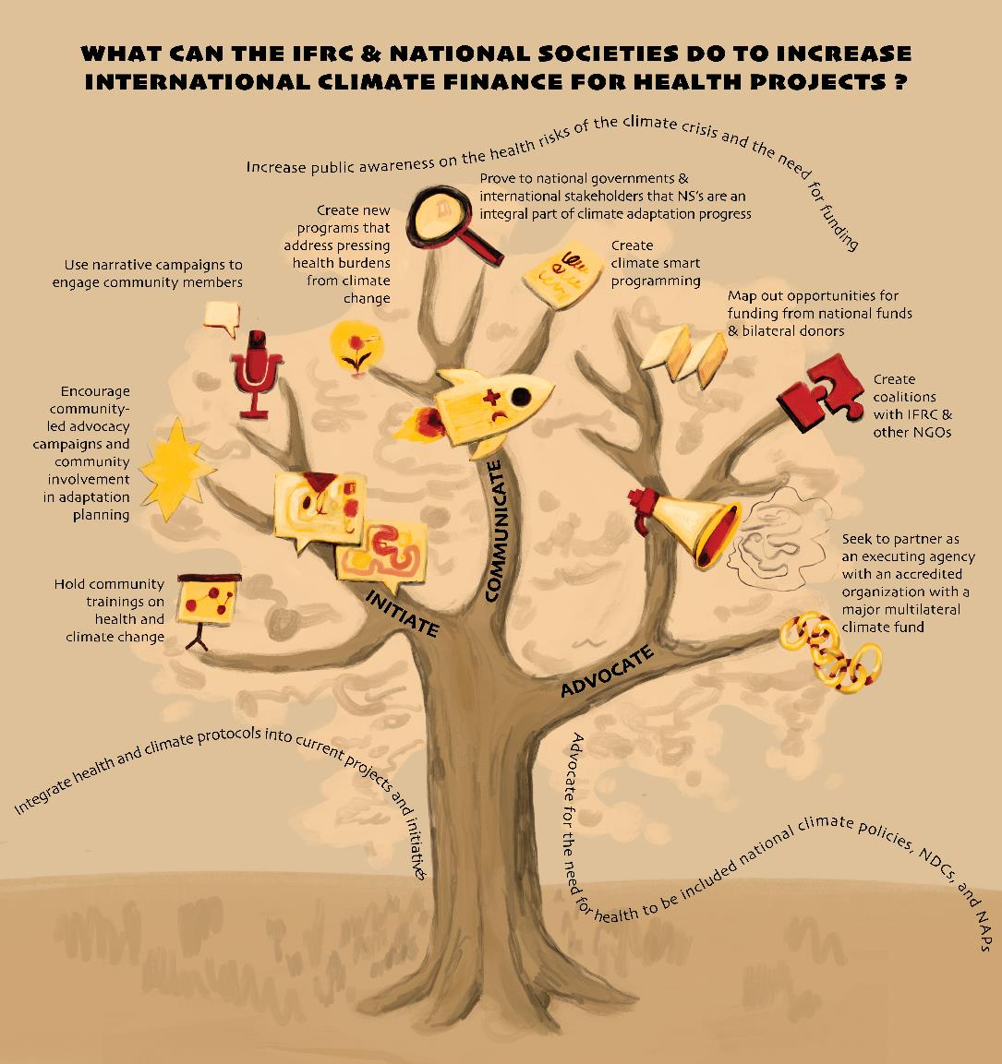
Notes:
Image credit: Rebeka Ryvola for the Red Cross Climate Centre
Notes:
What can National Societies do to support climate finance efforts for the health sector?
We divided actions into three categories: Initiate, communicate, and advocate.
Initiate focuses on integrating health and climate protocols into current projects and initiatives by creating climate-smart programming and developing programs that will address local needs related to health burdens of climate change. Doing so will help prove to national governments that national societies - with their strong health portfolio's – are an integral part of climate adaptation in their country.
Communicate to increase public awareness on the health risks of the climate crisis and the need for funding. You can do this by using narrative campaigns to engage community members and talk about climate impacts. National societies can hold trainings for volunteers and the public on the health impacts of climate change. National societies can also encourage public participation in advocacy initiatives and adaptation planning.
A final note of advice:
Lastly, national societies should advocate for the need for health to be included national climate policies, NDCs, and NAPs. This can be done by mapping out funding opportunities from national governments and multilateral funds, if any. Create coalitions with the IFRC and other NGOs in order to expand reach of influence. Engaging in national climate adaptation planning is vital for accessing climate finance. Climate finance priorities are based on national planning documents called National Adaptation Plans (NAPs) and Nationally Determined Contributions (NDCs). Ideally, national societies should be involved in helping shape these documents. In doing so, they can ensure that national planning documents reflect the NS’ climate priorities (including on health) and position NS as potential climate finance recipients. For more information, see IFRC Guidance on NAP Engagement. Lastly, National Societies can strive to partner with an climate fund accredited organization that will or has received climate finance funding from a multilateral climate fund. NS leadership should work on developing partnerships with accredited entities and national ministries involved in adaptation planning, to demonstrate the valuable role NS already play in locally led adaptation. Where possible, the IFRC and PNS should support NS to connect to climate finance opportunities domestically and internationally.

